Slide 1
CSS for beginners part 1

Slide 2
Hello world!
I AM PATRICIA REDDY
I am a software engineer at Entelect.
You can find me at:
patricia.reddy@entelect.co.za

Slide 3
Recap
Some structural elements
Tags to group our data
Lists
Semantic tags
Attributes
Notes:
Covered things like lists, unordered lists, ordered lists, list items
Covered Semantic tags, for example <headers> <footer> <article> <section>
You also went over attributes, which are used to add additional information or characteristics to elements.

Slide 4
Today
Introduction to CSS
Syntax & How to use
Colours
Fonts
Sizes
Borders
Margin & Padding
Text Align & Comments

Slide 5
Cascading Style Sheets
Style sheet language
Controls web page layout
Manage styles in website
Notes:
CSS stands for Cascading Style Sheets.
It is a style sheet language that allows to control web page layout.
For example where elements are positioned on the web page.
It also allows us to make the page look more user friendly by adding colour, borders, different font style.
Makes it easier to manage styles in a web site.

Slide 6
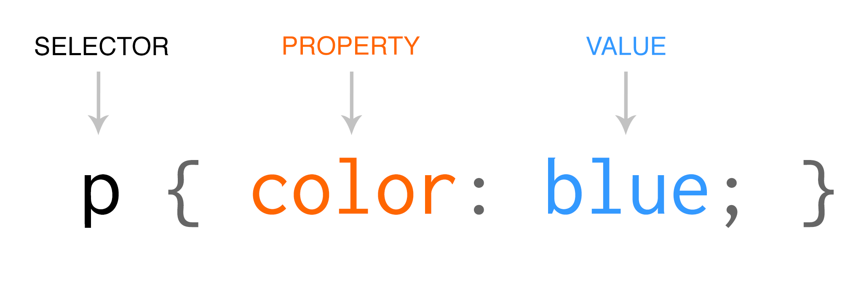
CSS: Syntax
A Selector and
declaration
Selector: HTML
element
Declaration:
Property and value

Slide 7
How do we use CSS?
Inline CSS
Contained in html element itself
Internal CSS
Contained in style tag in head section
External CSS
Contained in a file
<p style=“color: blue”>Hello World</p>
<head>
<style type=“text/css”
p { color: blue; }
</style>
</head>
<head>
<link rel=“stylesheet”
href=“style.css”>
</head>
Notes:
Inline styles are applied directly to the element, it can contain any CSS property.
It is the easiest and quickest way to style an element.
Can start to look messy.

Slide 8
How do we use CSS?
Inline CSS
Contained in html element itself
Internal CSS
Contained in style tag in head section
External CSS
Contained in a file
<p style=“color: blue”>Hello World</p>
<head>
<style type=“text/css”
p { color: blue; }
</style>
</head>
<head>
<link rel=“stylesheet”
href=“style.css”>
</head>
Notes:
Internal styles are defined in the style element, which is contained in the head section of the web page.
Allows for all styles to be contained in a central place.
Makes code look a lot neater.

Slide 9
How do we use CSS?
<p style=“color: blue”>Hello World</p>
<head>
<style type=“text/css”
p { color: blue; }
</style>
</head>
<head>
<link rel=“stylesheet”
href=“style.css”>
</head>
Inline CSS
Contained in html element itself
Internal CSS
Contained in style tag in head section
External CSS
Contained in a file
Notes:
With External style sheets, the page must reference the file in the <link> element which must be contained in the head section.
The advantage of having external style sheets is that your css for the entire page/website lives in one place.
It is important to note that these external style sheets must have the .css extension.

Slide 10
Activity: Basic Template
Make sure you have the latest CV template.
Open it in the browser.

Slide 11
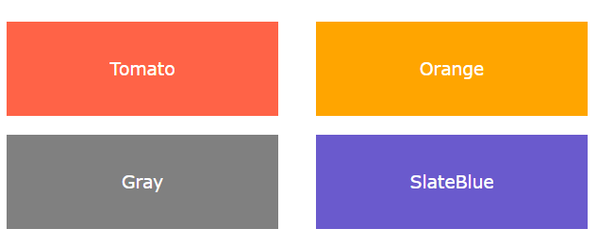

CSS: Colors
2 ways to add colour:
Color Names
Color Values
Colour Names
140 standard color names
Colour Values
RGB, HEX
Notes:
There are two ways you can add color to elements, by using Color Names or Color Values.
CSS has a predefined list of 140 colors that you can choose from.
Colors can also be specified using RGB, HEX.

Slide 12



CSS: RGB Colours
Use formula:
rgb(red,green,blue)
Each colour has a value between 0-255
These values define the intensity of the colour
Notes:
RGB colours are specified using the following formula : rgb(red, green, blue)
Each value can be in the range of 0 - 255
This value indicates the intensity of that colour i.e how dark or light the colour should be

Slide 13



CSS: HEX Colours
Specified with:
#RRGGBB
RR,GG,BB are values between 00-ff
These values define the intensity of the colour
Notes:
RGB colours are specified using the following formula : rgb(red, green, blue)
Each value can be in the range of 00 - ff
This value indicates the intensity of that colour i.e how dark or light the colour should be

Slide 14

CSS: Background Colour
Set background colour using background-color property.
Colour can be set using Colour Name or Colour Value
<p style=“background-color: tomato;">Hello World</p>
<p style=“background-color: #ff6347">Hello World</p>
<p style="color: rgb(255,99,71)">Hello World</p>

Slide 15
CSS: Text Colour
Set using the color property
Colour can be set using Colour Name or Colour Value
<p style="color: red;">Hello</p>
<p style="color: #ff0000">Hello</p>
<p style="color: rgb(255,0,0)">Hello</p>
Notes:
The colour property is used to set the colour of text elements.
The colour can be set using Colour Name e.g red, or by using Colour values e.g Hex value or rgb value.
To be compliant with w3c, if you set the colour property, you have to set the background-color property.

Slide 16
Activity: Background & text colour
Use the background-color property set the background colour for the below:
header - rgb(248, 242, 236)
article - rgb(248, 242, 236)
footer - rgb(204, 0, 0)
2. Use the colour property set the colour for My Resume, My Work and My Skills to white – rgb(140, 140, 140)

Slide 17


CSS: Borders
<p style=“border-style: solid;"></p>
<p style=“border-bottom-style: solid;"></p>
Allows you to set element border.
You can set the border style, color, width
Sets border on all sides of element, or a single side.
Notes:
CSS borders allows you to set the border of HTML elements.
You can specify the width of the border, the style of the border and the color of the border.
You can also specify if you want an element to have a border on all sides, 1 side, 2 sides, etc.

Slide 18


CSS: Border Width
<p style="border-style: solid; border-width: thick;"></p>
<p style=“border-style: solid; border-width: 2px;"></p>
Sets width using border-width property
3 predefined values: thin, medium, thick
Set specific values: px,cm,em etc
Notes:
CSS borders allows you to set the border of HTML elements.
You can specify the width of the border, the style of the border and the color of the border.
You can also specify if you want an element to have a border on all sides, 1 side, 2 sides, etc.
Values can be specified in the following unit, pixels, centimeters, em etc.

Slide 19



CSS: Border Style
<p style="border-style: solid;">Hello</p>
<p style="border-style: dashed;">Hello</p>
<p style="border-style: dotted solid;">Hello</p>
Sets style using border-style property
A number of values: solid,dashed,dotted
Notes:
To set the border style of an element, you need to use the border-style property.
The border-style property has 1 to for values, for setting top-border, left-border, right-border and left-border.
There are a number of different border styles that you can choose from, eg a solid line, dashed line, dotted line etc

Slide 20

CSS: Border Colour
Sets colour using border-color property
Can be set using Colour Names or Colour Values
<p style="border-style: solid; border-color: red;">Hello</p>
<p style="border-style: solid; border-color: #ff0000">Hello</p>
<p style="border-style: solid; border-color: rgb(255,0,0)">Hello</p>
Notes:
Setting the colour of the border is done by using the border-color-property.
Like the border-style property, the border-color also allows you to set the colour for top-border, bottom-border, right-border and left-border.
You can choose to use either Colour Names or Colour Values when setting the border-color property.

Slide 21

CSS: Border Radius
border-radius property adds rounded borders
border-radius is specified using px or % e.g 2px, 50%
To create a circle, set the height and width of the element to the same size and set the border-radius to 50%.

Slide 22

CSS: Border Radius
<div style="width: 100px; height:100px; background-color: red; border-radius: 50%;"></div>

Slide 23
Activity: Adding Borders
1. Use the border-radius property together with the width and height property to set the border for My Resume, My Work and My Skills

Slide 24
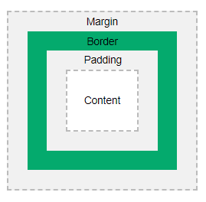
CSS: Margins
Creates space around element, outside the border
Properties: margin-top,margin-left,margin-bottom,margin-right
Set margin length: px,cm etc
Notes:
Margins are used to create around the element, outside any defined borders.
This is specified by using the margin property.
You can set the margin off all for sides or for each side of the element.
The box model is a box that wraps around html elements.
It consists of the actual content, then the padding, border and margin.

Slide 25
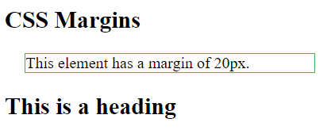
CSS: Margins
<p style="border-style: solid; margin: 20px;">This element has a margin of 20px.</p>
Notes:
Margins are used to create around the element, outside any defined borders.
This is specified by using the margin property.
You can set the margin off all for sides or for each side of the element.

Slide 26
CSS: Padding
Creates space around element, inside the border
Properties: padding-top,padding-left,padding-bottom,padding-right
Set padding length: px,cm etc
Notes:
Padding creates space around an elements content, inside any define borders.
This is achieved by using the padding property.
Like margins, you can set the padding for all sides off the element or for each side.

Slide 27
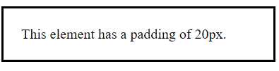
CSS: Padding
<p style="border-style: solid; padding: 20px;">This element has a padding of 20px.</p>
Notes:
Padding creates space around an elements content, inside any define borders.
This is achieved by using the padding property.
Like margins, you can set the padding for all sides off the element or for each side.

Slide 28
Activity: Adding Padding
In the <li> tags for My Resume, My Work and My Skills, add a <p> tag around these words.
Using the padding-top property, add a padding of 50px to the <p> tag.

Slide 29
CSS: Font Family
Specify font using font-family
font-family should have more than one comma separated value
Font names that are more than one word should be in quotes.
<p style="font-family: Arial;">Hello</p>
<p style="font-family: Arial,Helvetica;">Hello</p>
<p style="font-family: "Times New Roman";">Hello</p>
Notes:
Choosing the right font is very important, you want it to be easy to read and it should add some sort of value to your text.
To set the font family use the font-family property.
Typically you want to specify more than one value as a fail safe for different browser capabilities.
It is important to note that if the font name is more than one word, the font name must be in quotes.

Slide 30
CSS: Font Style
Specify font style using font-style
3 possible values:
Normal
Italic
<p style="font-style: normal;">Hello</p>
<p style="font-style: italic;">Hello</p>
Notes:
To set the font style, use the font-style property.
There are 2 values that you can use: normal, italic.

Slide 31
CSS: Font Weight
Specify font weight using font-weight
2 possible values:
Normal
Bold
<p style="font-weight: normal;">Hello</p>
<p style="font-weight: bold;">Hello</p>
Notes:
The font weight is set using the font-weight property.
There are 2 possible values to choose from: normal or bold.

Slide 32


CSS: Font Size
Specify font size using font-size
This should not be used for adjusting heading tags.
Font size can be set using pixels or with ‘em’: 1em = 16px
<p style="font-size: 20px;">Hello</p>
<p style="font-size: 2em;">Hello</p>
Notes:
Font size is achieved using the font-size property.
It is important to note that you should not use this to change the sizes of headings. You shouldn’t change the size of paragraphs to look like headings, or heading to look like paragraphs.
Always use the proper tags for what is was intended <h1> - <h6> for headings and <p> for paragraphs.
If the font size is not specified it is defaulted to 16px.
1em is equal to current size. The default size is 16px. So 1em = 16px, 2em = 32px etc.

Slide 33
Activity: Style some fonts
1. Change the font for job title to “Arial” using the font-style property.
2. Change the font weight for Hello to “bold” using the font-weight property.
3. Change the font size for about-you section to 32px using the font-size property.

Slide 34


CSS: Text Alignment
Set horizontal alignment using text-align
Can be aligned to the left,right,center, justified
Justify sets each line to equal length
<p style="text-align: center;">Hello</p>
<p style="text-align: right;">Hello</p>
<p style="text-align: left;">Hello</p>
Notes:
You can align text by using the align-text property.
Text can be left aligned, right aligned, center aligned or justified.
If you set text-align to justify, each line is stretched so that they are of equal width.

Slide 35
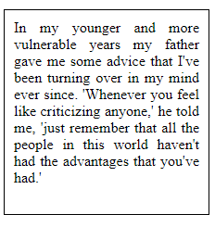
CSS: Text Alignment
<p style="text-align: justify;">In my younger and more vulnerable years my father gave me some advice that I've been turning over in my mind ever since. 'Whenever you feel like criticizing anyone,' he told me, 'just remember that all the people in this world haven't had the advantages that you've had.'</p>

Slide 36
CSS: Comments
Helps document code
Not displayed in browser
Can be added to the style section and html source.
<style> p { color: red; /* Set text color to red */ } </style>
<!-- These paragraphs will be red --> <p>Hello World!</p>
Notes:
Comments help you document and explain what your code is doing.
Comments are not displayed in the browser.
Comments can be added to <style> section using /*…*/
They can be added to html source using <!-- … -->

Slide 37
Thanks!
ANY QUESTIONS?
You can find me at:
Patricia.reddy@entelect.co.za

